Slide 1


Addressing challenges in personalized prophylaxis:
the role of Big Data
Population Pharmacokinetics of Factor VIII and IX concentrates
Alfonso Iorio, MD, PhD
Health Information Research Unit
Hamilton-Niagara Hemophilia Program
McMaster University
Food and Drug Administration
Washington, DC
April 27th, 2015

Slide 2
Outline
Background
WAPPS
  Hemophilia
  PK in hemophilia
  Tailored treatment
  Population PK
Project outline
Project design
Project status
Project deliverables
Future steps
www.wapps-hemo.org
Open questions
Business model

Slide 3
Outline
Background
WAPPS
  Hemophilia
  PK in hemophilia
  Tailored treatment
  Population PK
Project outline
Project design
Project status
Project deliverables
Future steps
www.wapps-hemo.org
Open questions
Business model

Slide 4

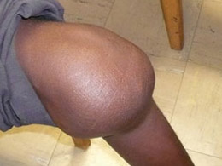
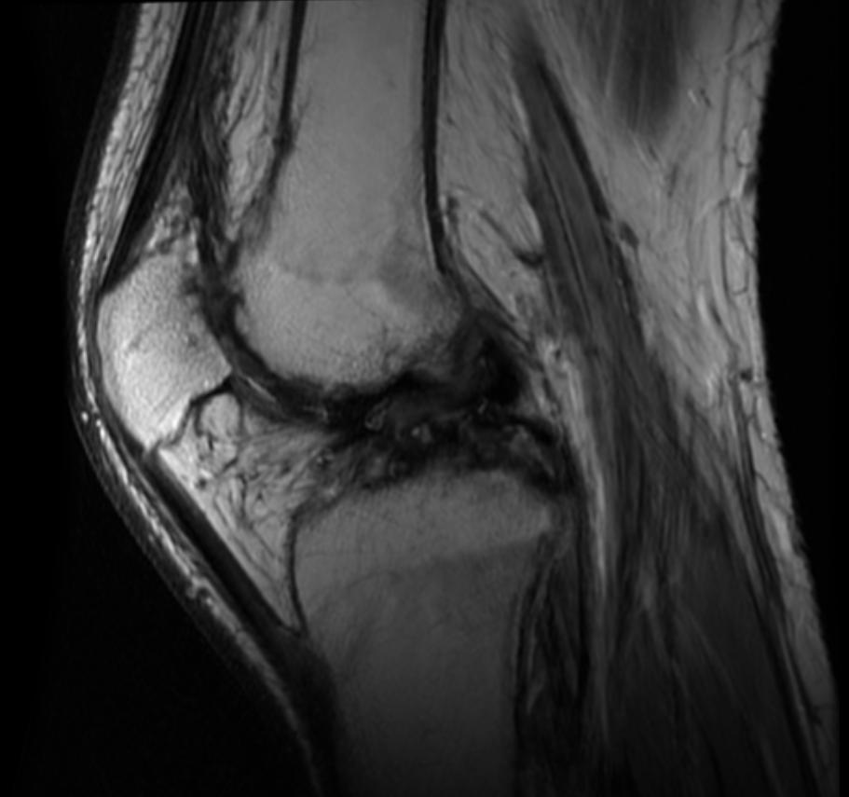
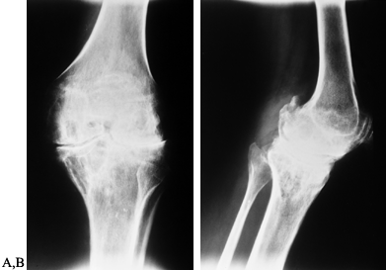
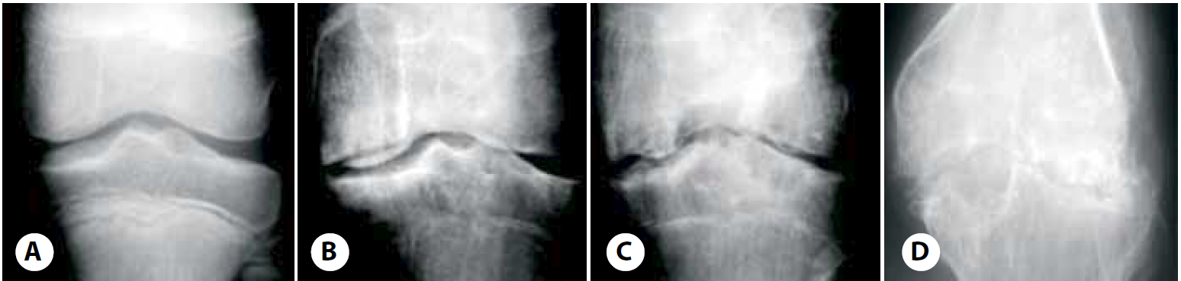
A picture is worth 1000 words
Natural history
Notes:
Image slides
Try to emphasize your concepts with pictures. And I tend to use real pictures – pictures of the companies and executives that are the subjects of my stories.
Or I’ll choose a picture that elicits an emotional response to a key point I’m making. It’s important to touch a listener’s heart and head.
Slide Notes:
Note the left bar color aligns with the section color – visual clue that I’m still in Section 1.
To set a picture as a slide background, as on this slide, hold down CONTROL, click the slide and then click Format Background.

Slide 5
Treatment
Factor concentrate
Hemophilia severity
Prophylaxis

Slide 6
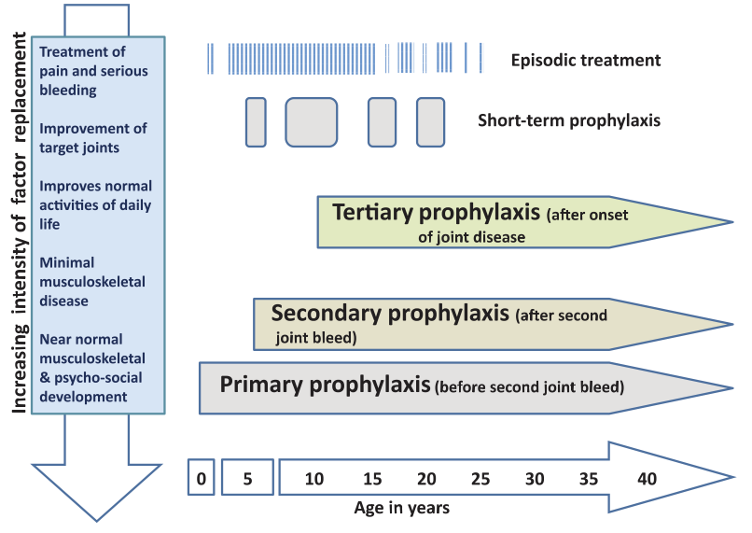
Strategies for Clotting Factor Replacement at Different Ages and Impact on Outcomes
Adapted from Coppola A, et al. Blood Transfus. 2008;6 Suppl 2:s4-11.
Notes:
I will touch upon th goal of prohylaxis being different for different class of patients
Reference:
Coppola A, Di Capua M, De Simone C. Primary prophylaxis in children with haemophilia. Blood Transfus. 2008;6 Suppl 2:s4-11.

Slide 7


Pharmacokinetics and prophylaxis
– one tale or two stories?
Notes:
I will make the point that while we talk a lot of PK tailored approach, this was actually there since the very beginning
Will use two arguments
The Swedish prophylactic regimen was based on the PK assumption of keeping the through level > 1% all the time
The development/approval process for new concentrates (both PD an Rec) was based on demonstration of PK equivalence

Slide 8
Challenges to 1-size-all: 1st
Canada
Sweden
Egypt, China, India

Slide 9
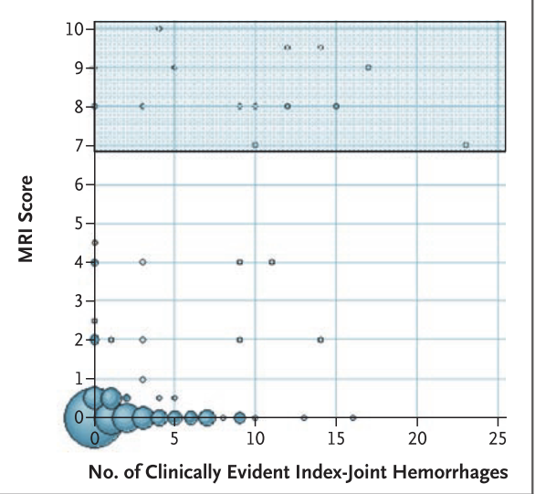
Challenges to 1-size-all: 2nd
Manco-Johnson MJ, Abshire TC, Shapiro AD, et al.
Prophylaxis versus episodic treatment to prevent joint disease in boys with severe hemophilia.
N Engl J Med 2007;:535–44.

Slide 10
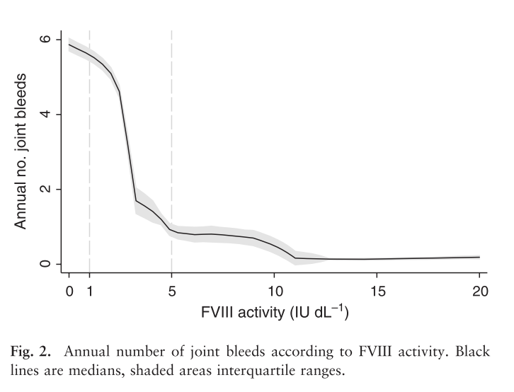
Challenges to 1-size-all: 2nd
Clinical severity of haemophilia A: Does the classification of the 1950s still stand?
den Uijl IEM, Mauser Bunschoten EP, Roosendaal G, et al. Haemophilia 2011;17:849–53.

Slide 11
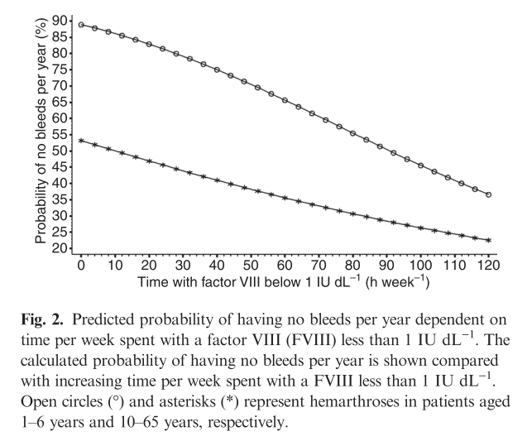
Challenges to 1-size-all: 2nd
Collins PW, et al.
J Thromb Haemost 2010;8:269–75.

Slide 12
Challenges to 1-size-all: 3rd
75 articles
2050 patients included in PK analyses.
38 on factor VIII concentrates
  HL(hr) for
    wild type 7.8 to 19.2,
    BDD 7.5 to 17.9
    prolonged HL 11.5 to 23.1
25 on factor IX concentrates.
  HL(hr) for
    wild type 12.9 to 36.0 ,
    prolonged HL 53.5 to 110.4
PHARMACOKINETIC CHARACTERISTICS OF FACTOR VIII AND IX CONCENTRATES – A SYSTEMATIC REVIEW
Xi M, Navarro-Ruan T, Mammen S, Blanchette V, Hermans C, Morfini M, Collins P, Fischer K, Neufeld EJ, Young G, Kavakli K, Radossi P, Dunn A, Thabane L, Iorio A for the WAPPS study group.

Slide 13
Challenges to 1-size-all: 3rd
Unpublished data, 1 single molecule
Estimated terminal t1/2 (hr)
Individual case

Slide 14
Personalized prophylaxis
Carcao M et Al - Individualizing factor replacement therapy in severe hemophilia - submitted

Slide 15
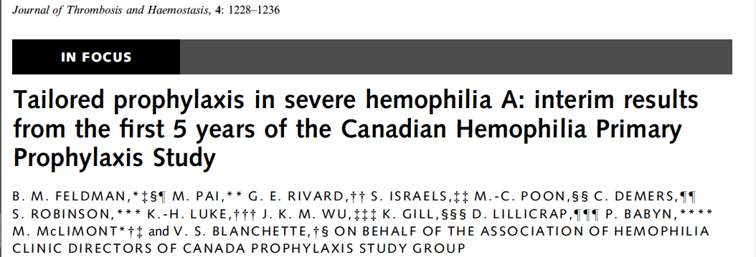
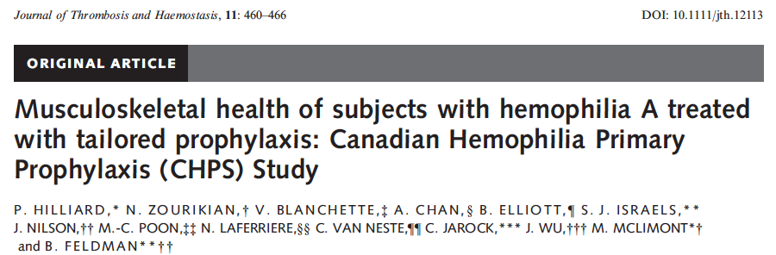
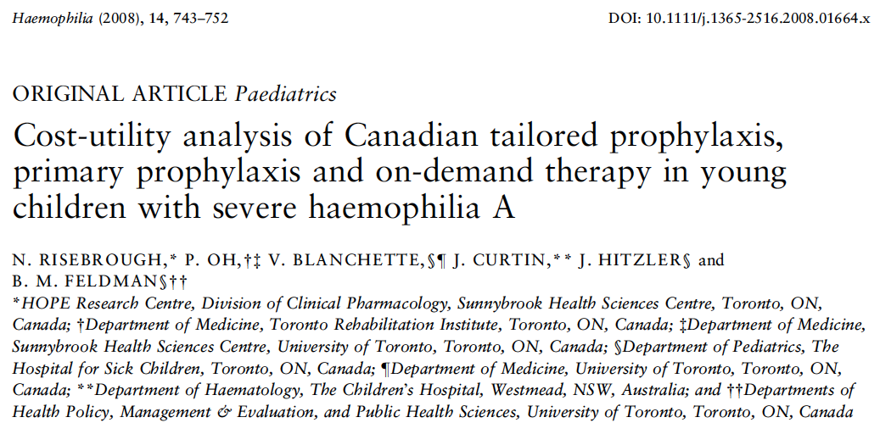
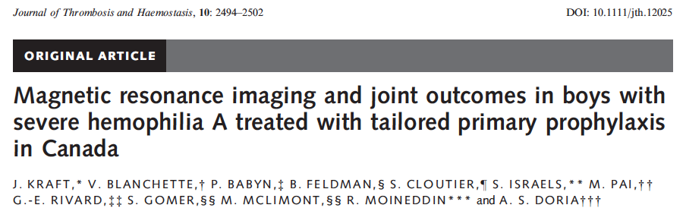
New era?

Slide 16


WAPPS: vision
Barrier:
Number of samples
PK
Solution:
Population PK

Slide 17
Population PK
Two main applications:
Drug oriented (derivation phase)
  Estimating the PK properties of a drug using sparse data from a population of subjects
Patient oriented (estimation phase)
  Estimating the PK in one individual using sparse data from him/her and a population model

Slide 18
Population PK
Classical approach
Mixed approach
Population approach
Derivation
Rich data in a
limited sample of
individuals
Average of iPK
Derivation
Rich data in a
large sample of
Individuals
Population model
Derivation
Sparse data in a
large sample of
individuals
Population model
Estimation
Full study (rich data)
of the individual of interest
Individual PK
Estimation
Bayesian estimation
individual sparse data population priors
Individual PK

Slide 19
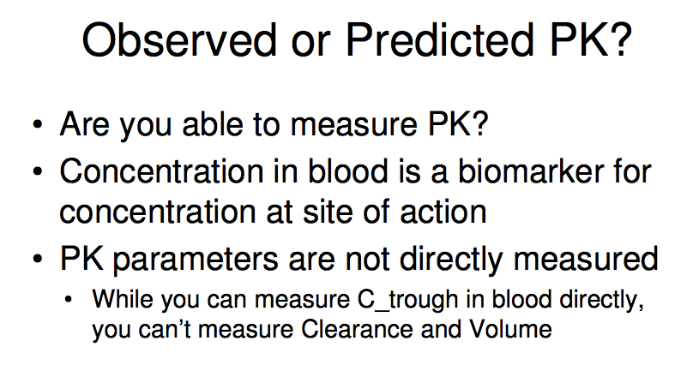
Compartmental modeling

Slide 20
Big Data technology
Addressing challenges in personalized prophylaxis: the role of Big Data
Big Data do not refer too the “size” of the dataset
Big Data refer to the statistical approach use to model variability in the observations

Slide 21
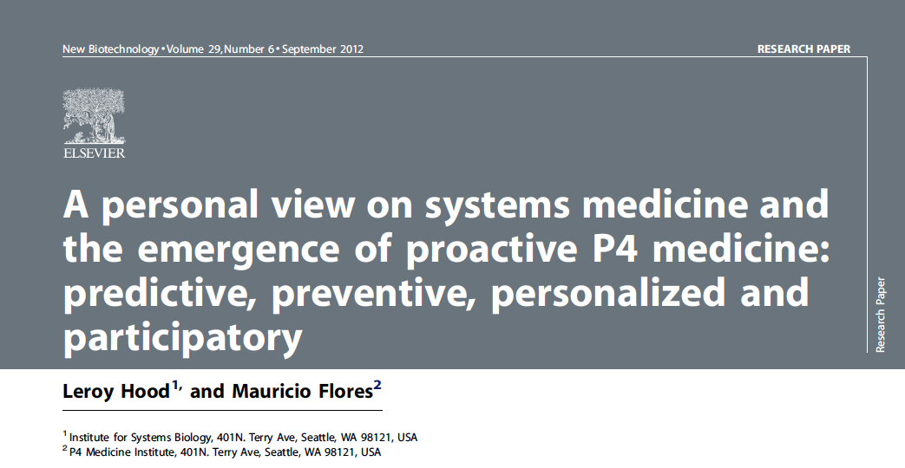
New perspective?
Hood L et al. P4 medicine: predictive, preventive, personalized and participatory. N Biotechnol 2012;29:613–24.

Slide 22
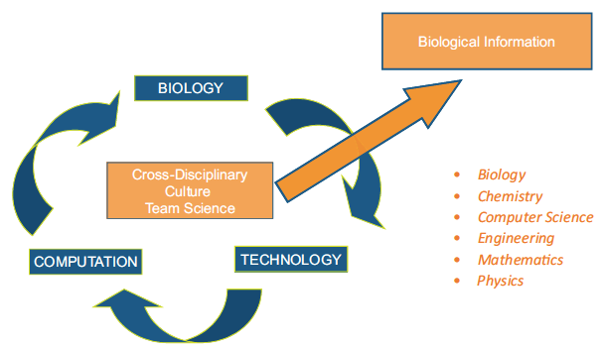
The holy trinity of biology
Hood L et al. P4 medicine: predictive, preventive, personalized and participatory. N Biotechnol 2012;29:613–24.

Slide 23
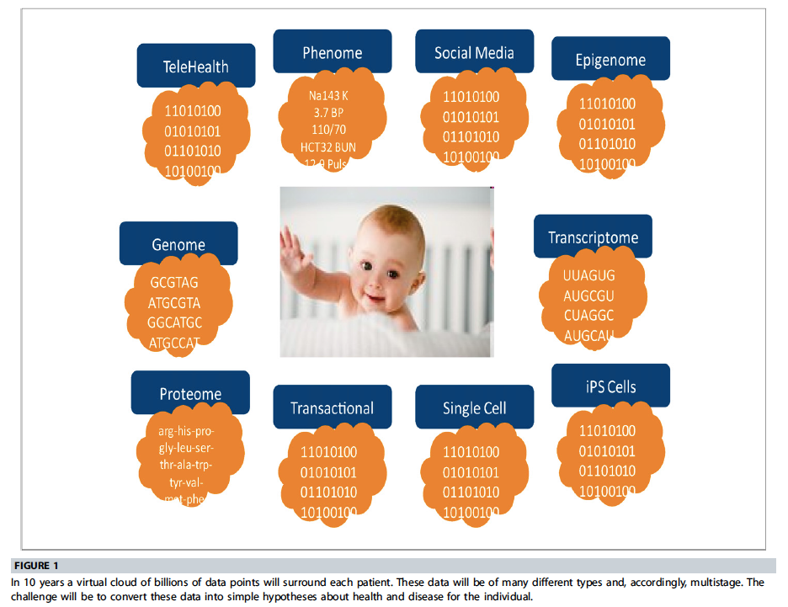
Hood L et al. P4 medicine: predictive, preventive, personalized and participatory. N Biotechnol 2012;29:613–24.

Slide 24
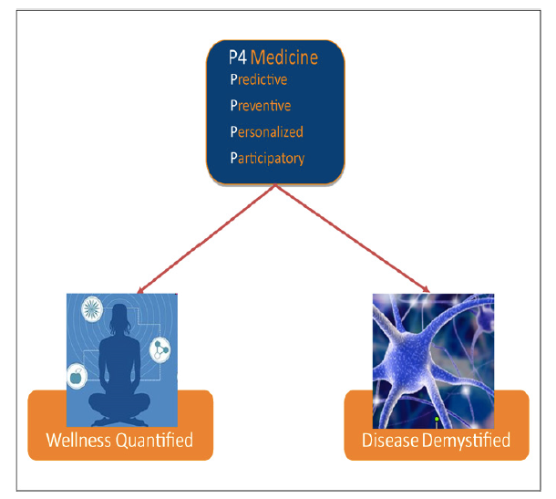
Hood L et al. P4 medicine: predictive, preventive, personalized and participatory. N Biotechnol 2012;29:613–24.

Slide 25
Proactive P4 medicine
EBM – reactive medicine | Proactive P4 medicine
Symptom based (reactive to sickness) | Pre-symptomatic markers based (pro-active)
Disease-treatment system | Wellness-maintenance system
Few measurements | Many (longitudinal) measurements (-omics)
Disease-centric, standard of care for population-based diseases | Individual-centric, standard of care based on multiple individual measurements
Records not highly linked | Deeply integrated data for healthcare scopes
KT mostly physician to physician | KT incorporating patients networks
Drugs tested in large populations | Large use of stratification (ideally < 50 pts)
Dominance of delivery of science based health care to inpatients | Healthcare delivered at home whenever possible, including measurements
Research and care connected by peer review literature | Discovery and practice integrated through heterogenous databases
Disease specific generic knowledge | Individual specific knowledge
To be retabulated after shortening content
Hood L et al. P4 medicine: predictive, preventive, personalized and participatory. N Biotechnol 2012;29:613–24.

Slide 26
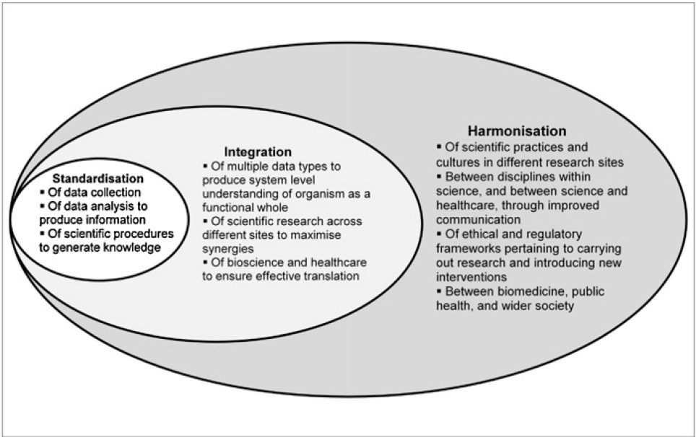
Harvey A et al. The future of technologies for personalised medicine. N Biotechnol 2012;29:625–33.

Slide 27
Outline
Background
WAPPS
  Hemophilia
  PK in hemophilia
  Tailored treatment
  Population PK
Project outline
Project design
Project status
Project deliverables
Future steps
www.wapps-hemo.org
Open questions
Business model

Slide 28
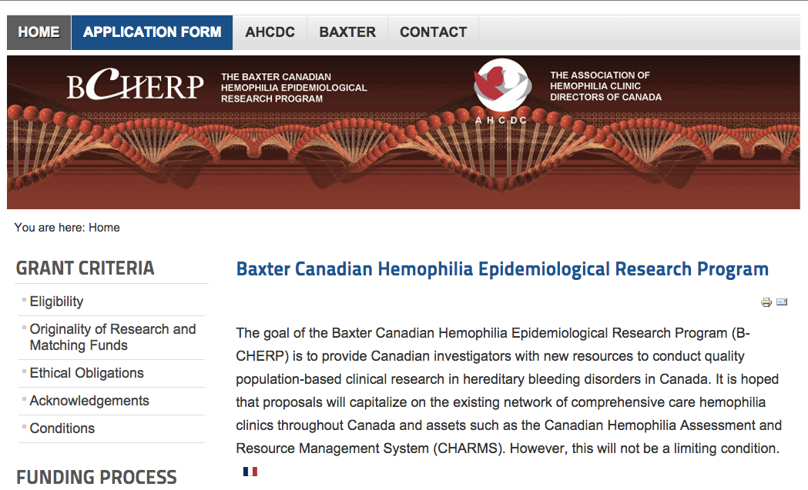
Funding source

Slide 29
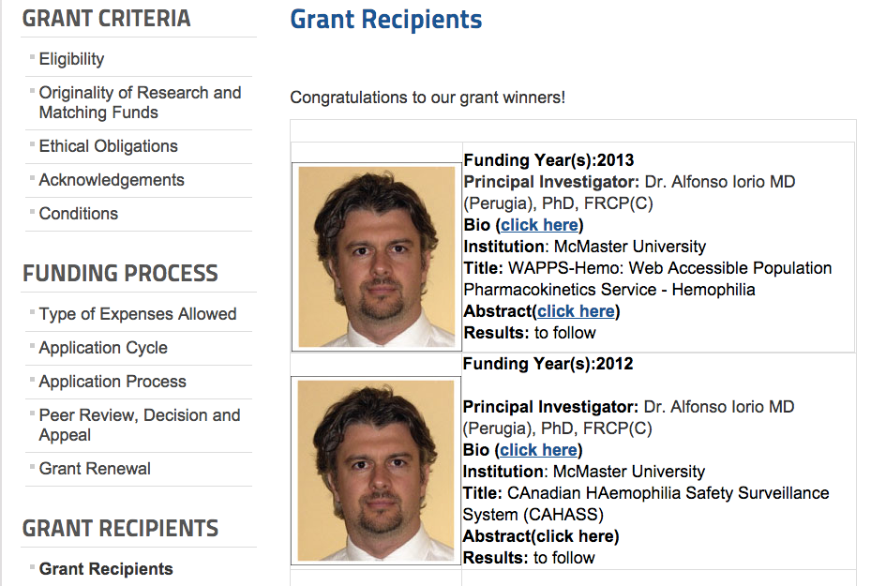

Slide 30
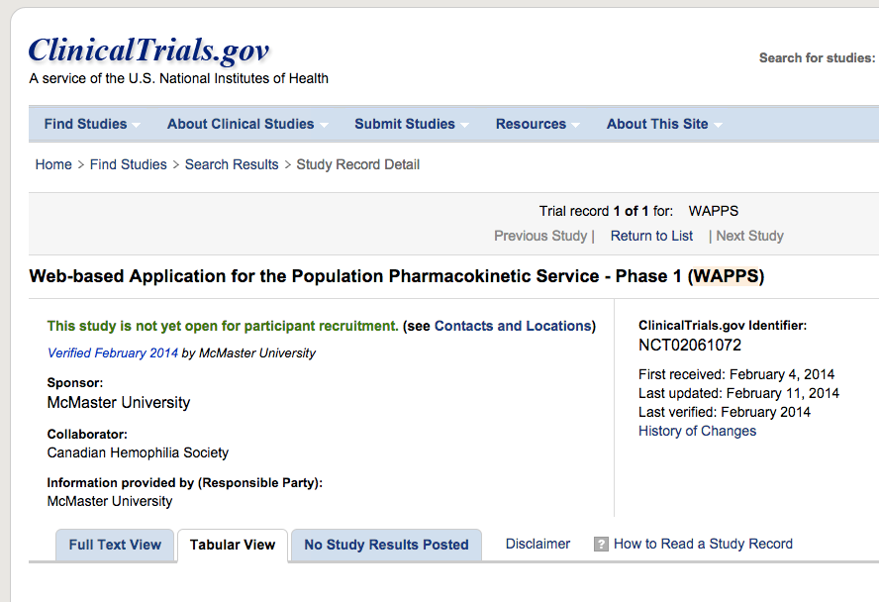
Trial registration

Slide 31
Single patient data
Web-application
Estimating PK for single individuals on the base of 2-4 samples
Single patient report

Slide 32
Estimating PK for single individuals on the base of 2-4 samples
Single patient data
Web-application
Online PPK engine
(NONMEM)
Single patient report

Slide 33
Estimating PK for single individuals on the base of 2-4 samples
Brand specific Source individual PK data
Single patient data
Control files for bayesian individual estimation
Web-application
Online PPK engine
(NONMEM)
Offline PPK modeling
ADVATE
KOGENATE
BENEFIX
ALPROLIX
ELOCTATE
Others..
Brand specific PPK models
Single patient report

Slide 34
Brand specific Source individual PK data
Single patient data
patients
patients
patients
Control files for bayesian individual estimation
Web-application
Online PPK engine
(NONMEM)
Offline PPK modeling
ADVATE
KOGENATE
BENEFIX
ALPROLIX
ELOCTATE
Others..
Brand specific PPK models
Single patient report

Slide 35
Status of the project
Team

Slide 36
The WAPPS core team
PI: Iorio, Alfonso and Hermans, Cedric
Advisory Committee: Blanchette, Victor; Collins, Peter; Morfini, Massimo;
Project coordinator: Navarro, Tamara
Information Technology: Cotoi, Chris; Hobson, Nicholas; McKibbon, Ann;
Pharmacokinetics: Edginton, Andrea;
Statistics: Foster, Gary; Thabane, Lehana;
Consultant: Bauer, Rob (Consultant at ICON)
Literature service, data entry: Xi, Mengchen; Mammen, Sunil; Yang, Basil;
User testing: Bargash, Islam

Slide 37
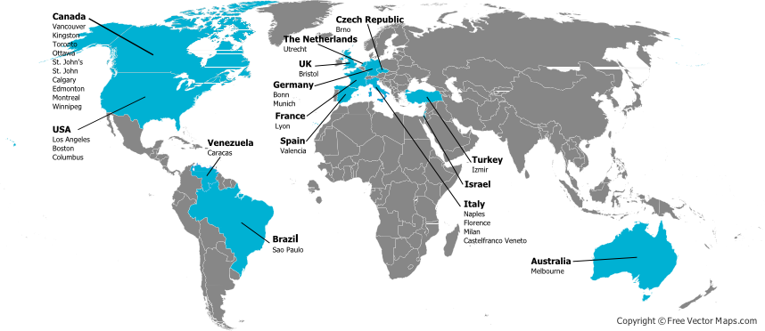
The WAPPS network

Slide 38
The network
Active centers
US Guy Young
TU Kaan Kavakli
US Ellis J. Neufeld
CA Shannon Jackson
IT Paolo Radossi
CA Paula James
CE Jan Blatny
CA Jerry Teitel
VZ Arlette Ruiz-Sàez
NL Kathleen Fischer
US Amy Dunn
CA Victor Blanchette
D Rainer Kobelt
In process
CA Alan Tinmouth
CA MacGregor Steele
UK Savita Rangarajan
SA Johnny Mahlangu
IT Alberto Tosetto
D Cristoph Bidlingmaier
IT Giancarlo Castaman
SL Barbara Faganel Kotnik
US Craig Kessler
47 more attended the introductory webinar

Slide 39
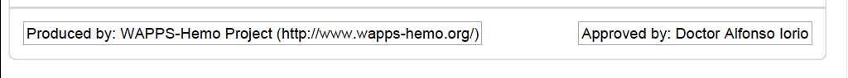
Medical Device Exemption?
Disclaimer: This is a research service under development, not yet validated for clinical practice use. Any use of the results of the population pharmacokinetic estimation in the care of individual patients is not recommended and cannot be considered part of the service in this phase. The local investigator is solely responsible for any such use.

Slide 40
Status of the project
Infrastructure

Slide 41
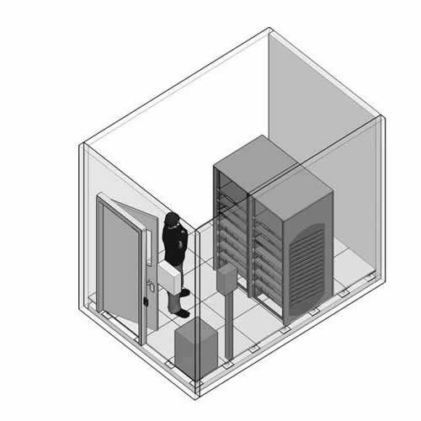
Hardware
2 geographically separated server rooms
Fully redundant hardware
(Master – Slave cluster)
Resilience software
Raid 5 Disk array
Controlled access server rooms
Swipe cards, access logging
24/7 recording cameras

Slide 42
Status of the project
Software

Slide 43

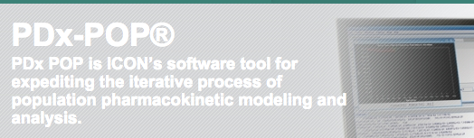
Software
Data Encription
  SQL enterprise with static encription
  https:\\ protocol
iIS and dot.net platform
NONMEM (Ver 7.3)
PDx-POP (Ver 5)
Tested on multiple browser

Slide 44
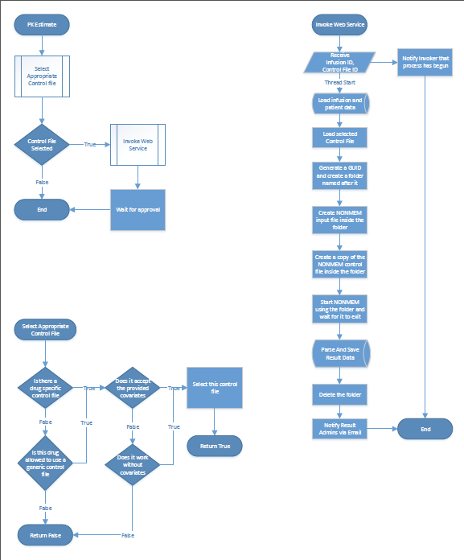
Project logic

Slide 45
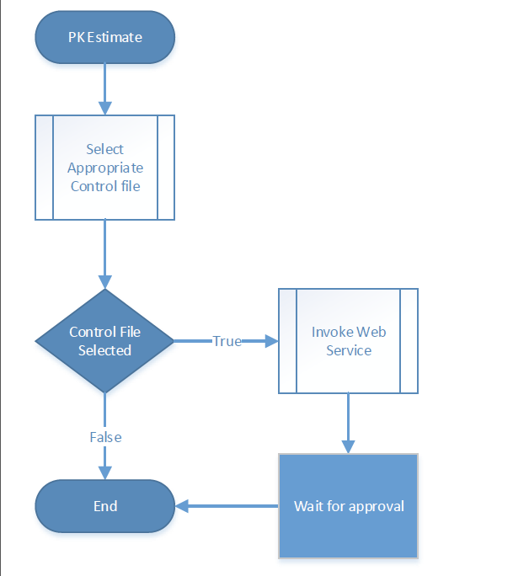

Slide 46
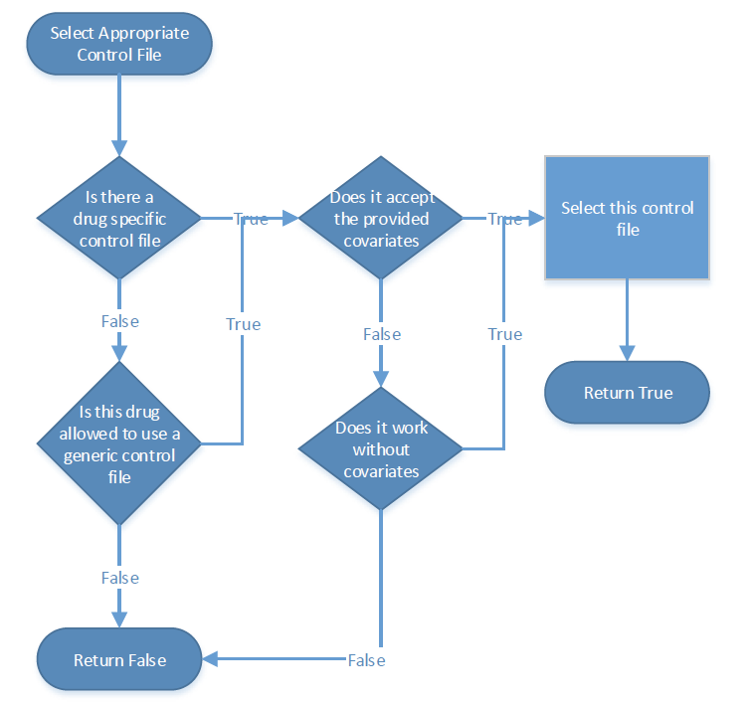

Slide 47
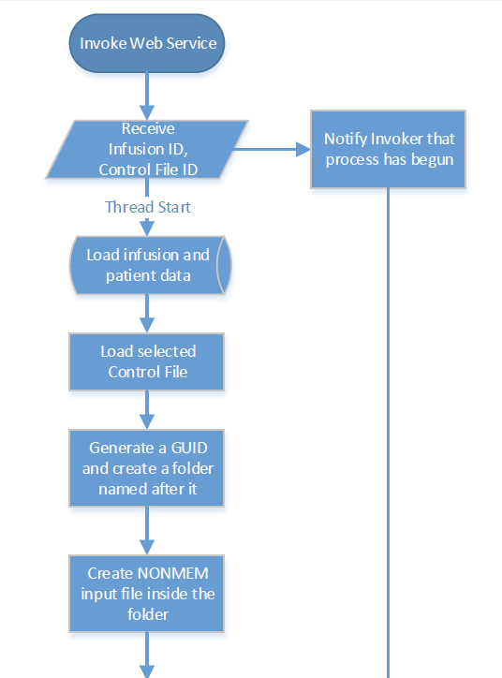
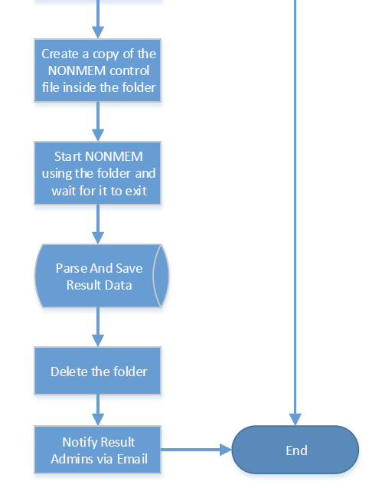
1
2

Slide 48
Status of the project
Modeling

Slide 49
Source data
 | Subjects | Replicates | n | Kinetics
Brand
A | 40 | 21 | 1 | 61
B | 80 | 58 | 4 | 312
C | 30 | 30 | 2 | 90
D | 167 | 30 | 1 | 197
E | 25 | - | - | 25
F | 129 | 20 | 1 | 149
Total | 471 | 159 |  | 834

Slide 50
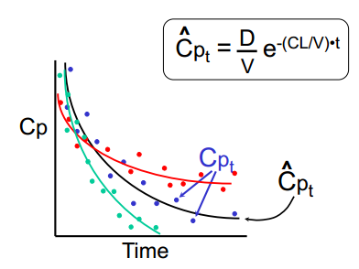
Modeling:
Base Structural Model

Slide 51
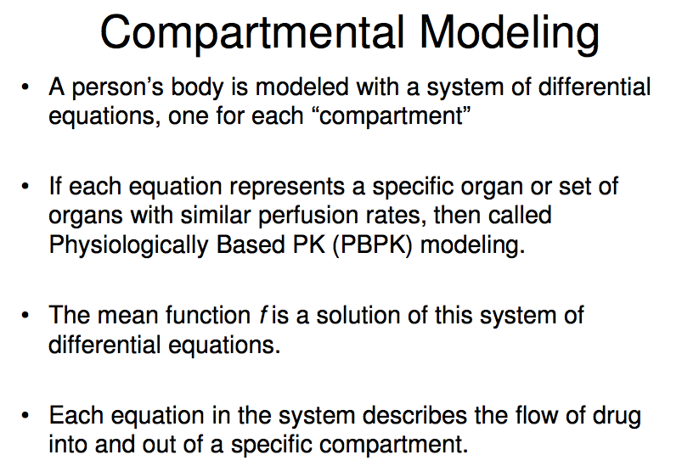

Slide 52
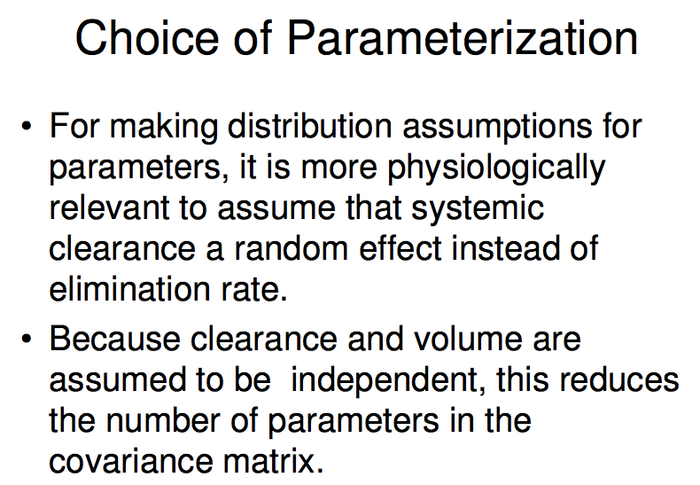

Slide 53
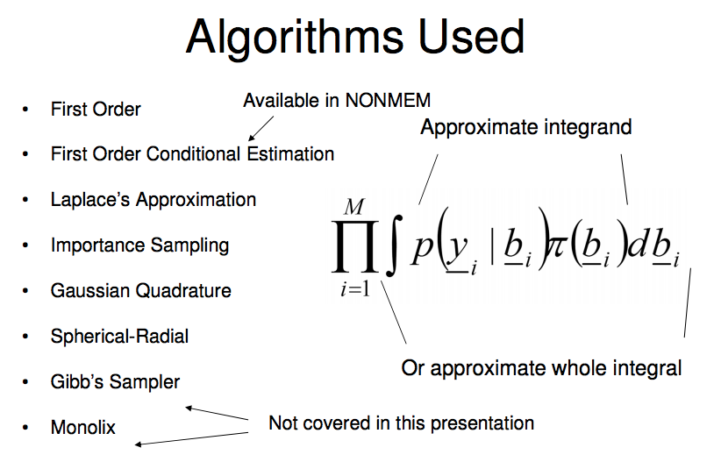
Mathematical implementation

Slide 54
Modeling:
Base Structural Model
Estimation
Method
Residual
Variability
Model
Parameters
Assessment
Type
IIV
  FO
  FOCE
  FOCEI
  Laplacian
1-cmt
Additive
CCV
Additive+CCV
Log Error
1-cmt
Cl
Vol
OBJF
Diagnostic
plots
Additive
Additive + CCV
Cl
CCV
Exponential
Vol
FOCEI
Notes:
Base compartment model – using CONCENTRATION and DOSE – we are estimate our two parameters of interest – clearance and volume
Objective function is based on extended least squares
Note: FOCEI is the current standard method for NONMEM analyses
FO – first order estimation; FOCE – first order conditional estimation;
FOCEI – first order conditional estimation interaction
Laplaian

Slide 55
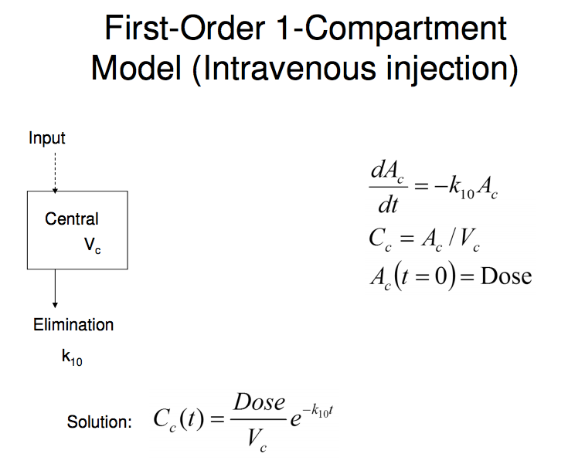
1-comp, microvariables

Slide 56
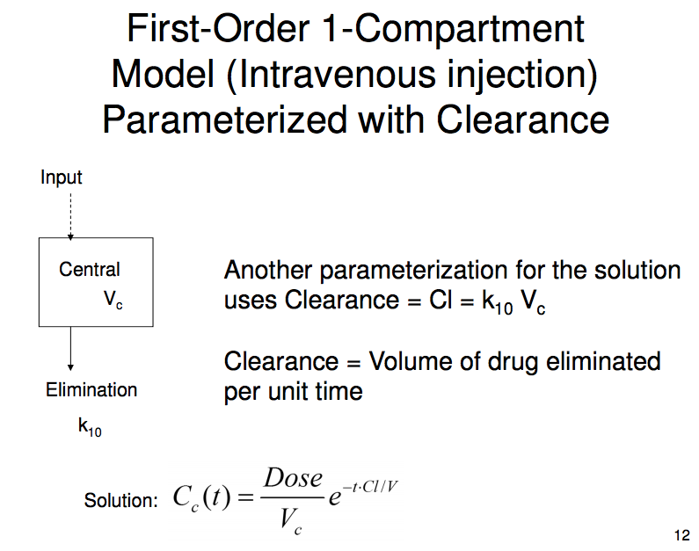
1-comp, macrovariables

Slide 57
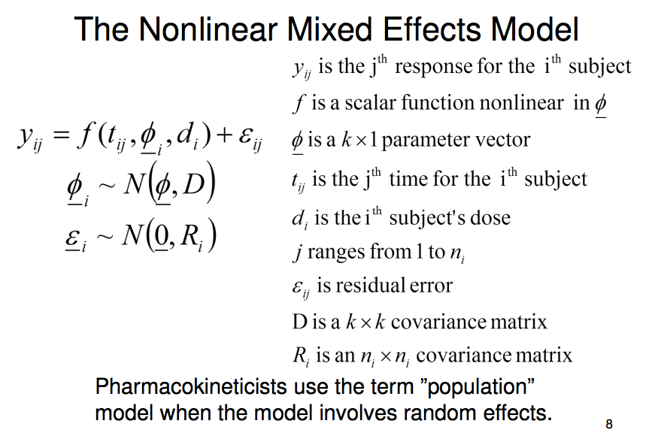
Population implementation

Slide 58
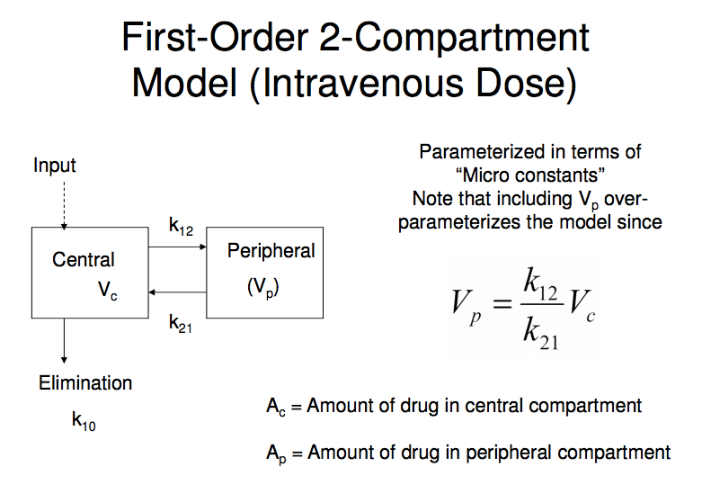
2-comp, microvariables

Slide 59
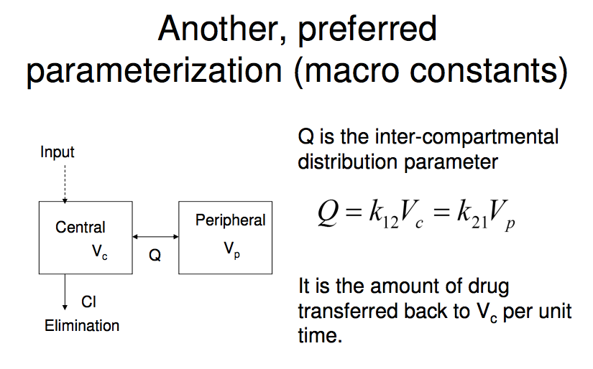
2-comp, macrovariables

Slide 60
WAPPS models
Drug | Type | Class | Gen ctrl | Pref Mod (Comp) | Alt model (Comp) | Active
Advate | F8 | R-wild | N | 2 | 1 | Y
Alprolix | F9 | R-long | N | 3 | 2 | Y
BenefIX | F9 | R-wild | N | 2 | -- | Y
Eloctate | F8 | R-long | N | 1 | 2 | Y
Humate P | F8 | PD | Y | 2 | 1 | Y
Kogenate | F8 | R-wild | N | 2 | 1 | Y
Wilate | F8 | PD | Y | 2 | 1 | Y
Xyntha | F8 | R-BDD | N | 2 | -- | Y

Slide 61
Published models
Drug | Refs | Comp
Advate | Bjorkmann, Eur J Clin Pharm, 2009; Blood, 2013; JTH 2010 Nestorov I, Clin Pharm in Drug Devel 2014 | 2
Alprolix | Diao, Clin Pharmacokinet 2014 | 3
BenefIX
Eloctate | Nestorov I, Clin Pharm in Drug Devel 2014 | 2
Humate P
Kogenate
Wilate
Xyntha | Karafoulidou, Eur J | 2

Slide 62
Outline
Background
WAPPS
  Hemophilia
  PK in hemophilia
  Tailored treatment
  Population PK
Project outline
Project design
Project status
Project deliverables
Future steps
www.wapps-hemo.org
Open questions
Business model

Slide 63
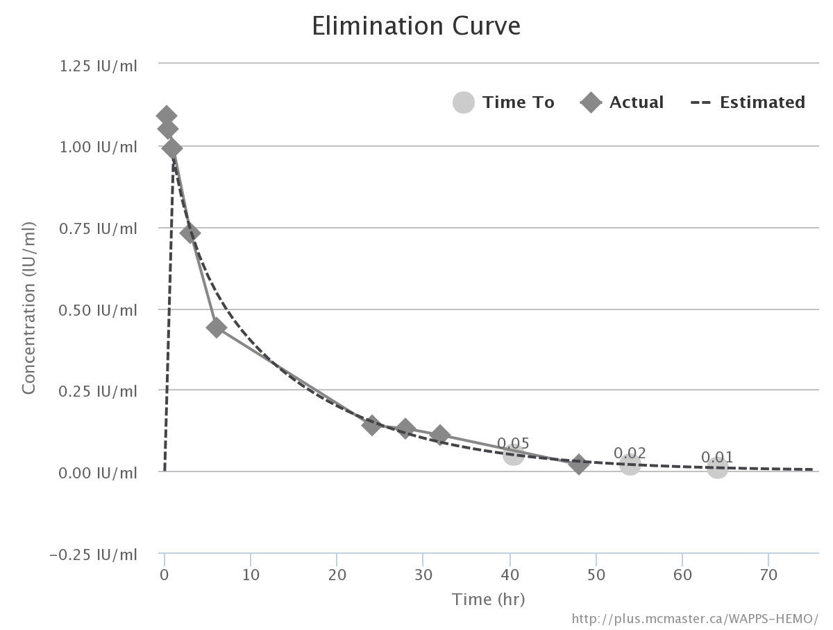
Bayesian estimate, rich data
Estimate | X | 95% CI
Terminal HL (hr) | 10
Time (hr) to UI/mL
0.05 | 40.5 | (38.25 - 42.5)
0.02 | 54 | (51 – 57)
0.01 | 64 | (60.25 - 68)

Slide 64
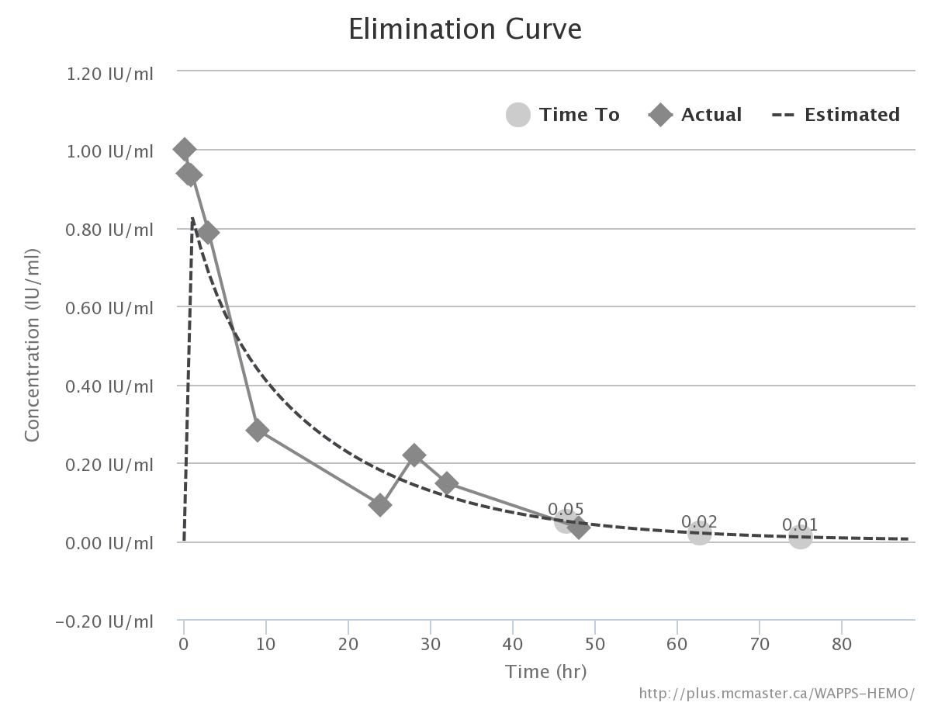
Bayesian estimate, rich data
Estimate | X | 95% CI
Terminal HL (hr) | 12
Time (hr) to UI/mL
0.05 | 46.5 | (39.75 - 53.25)
0.02 | 62.75 | (53.5 – 72)
0.01 | 75 | (63.5 – 86.25)

Slide 65
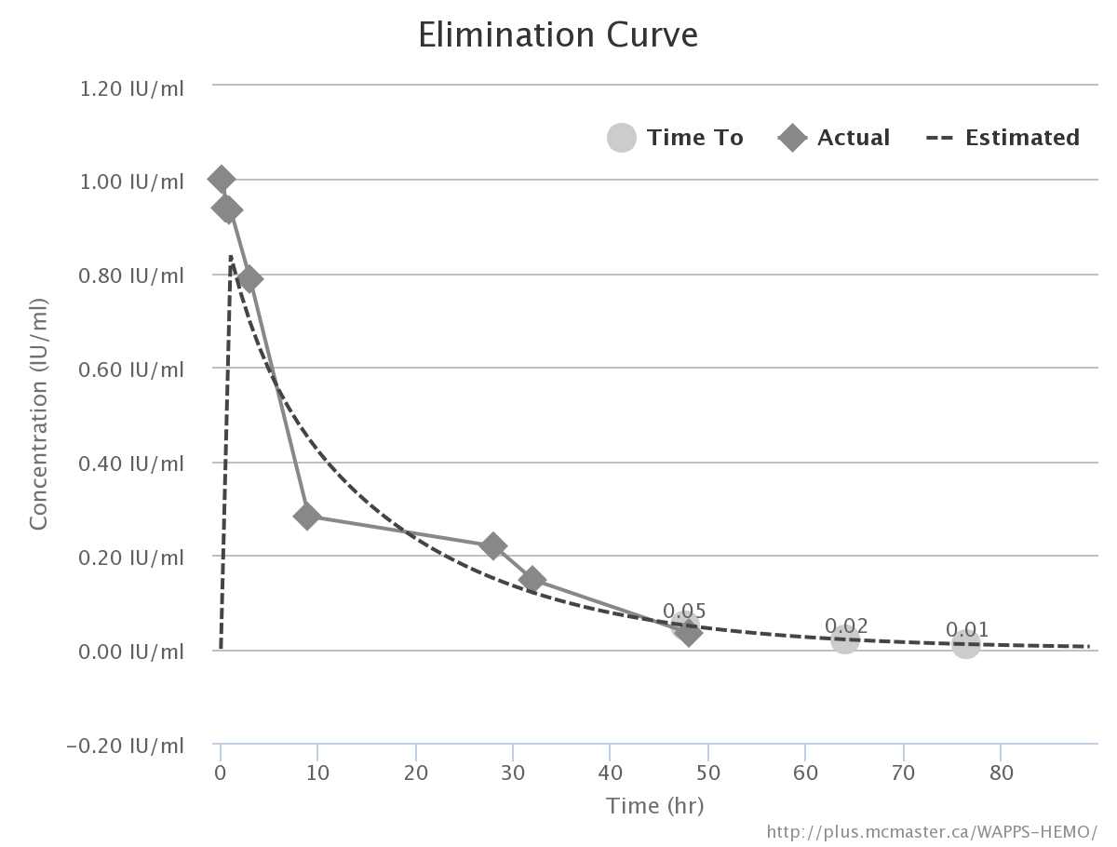
Bayesian estimate, rich data
Estimate | X
Terminal HL (hr) | +.5
Time (hr) to UI/mL
0.05 | +1.25
0.02 | +1.25
0.01 | +1.5
Dropping one point

Slide 66
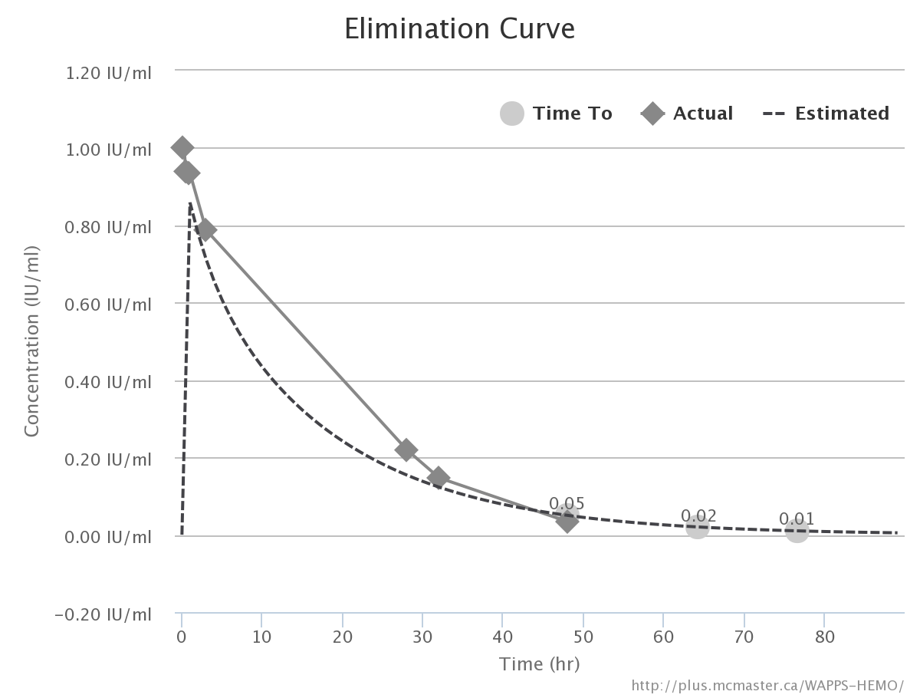
Bayesian estimate, rich data
Estimate | X
Terminal HL (hr) | +.5
Time (hr) to UI/mL
0.05 | +1.5
0.02 | +1.5
0.01 | +1.5
Dropping two points

Slide 67
Classical approach

Slide 68
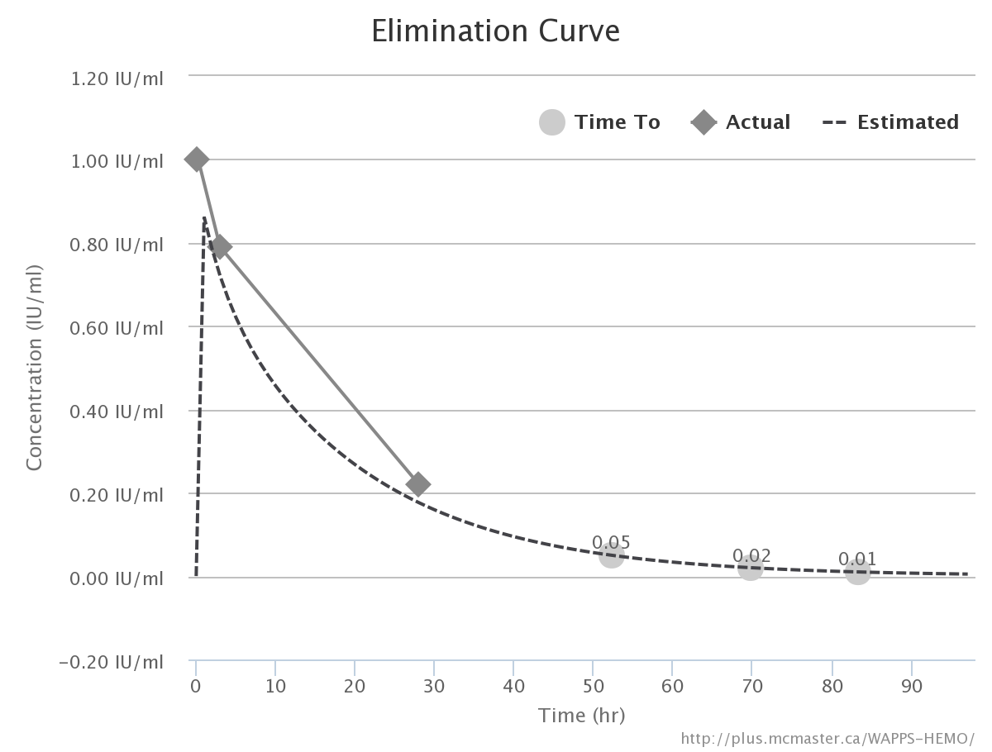
Bayesian estimate, 3 points

Slide 69
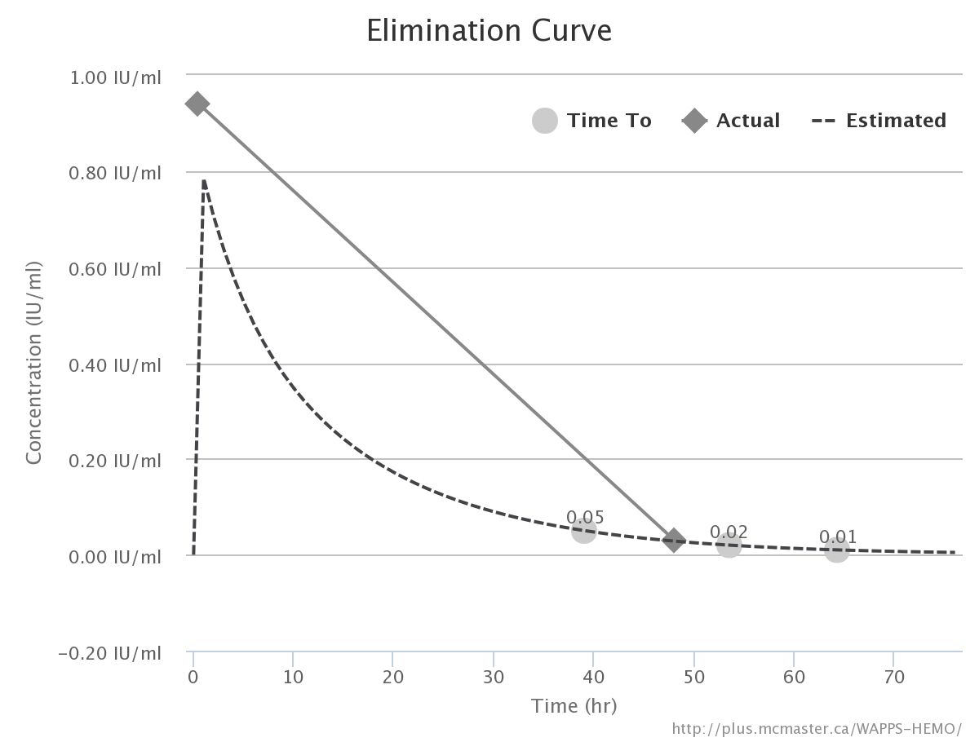
Bayesian estimate, 2 points

Slide 70
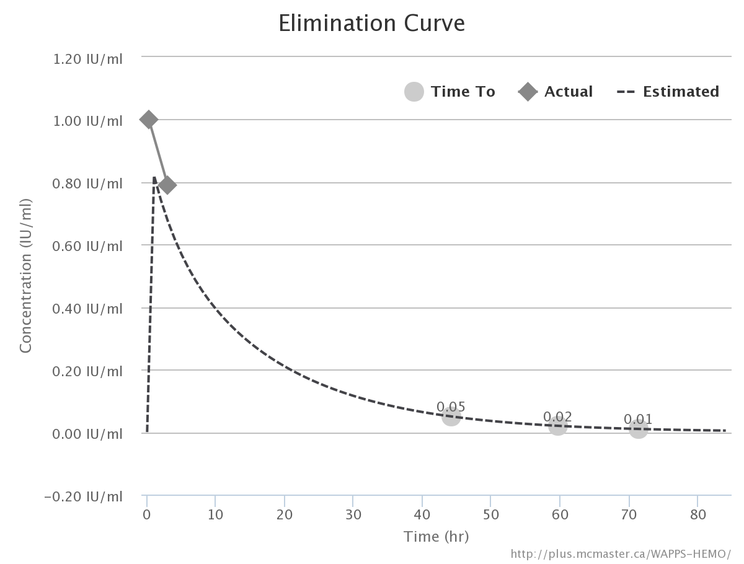
Bayesian estimate, 2 points

Slide 71
Bayesian estimate, reduced sets
Samples | Term HL | 0.05 | 0.02 | 0.01
0:15 → 48 | 12 | 46.5 (38.75 - 53.25) | 62.75 (53.5 – 72) | 75 (63.5 – 86.25)
0:15, 3, 28 | 13.5 | 52.5 (36.75 – 67.75) | 70 (49.25 – 90.5) | 83.25 (58.75 – 107.75)
0:30, 48 | 11.0 | 39 (31.15-46.75) | 53.5 (44 – 63) | 64.5 (53.25 – 73.5)
0:15, 3 | 11.5 | 44.25 (22.5 – 66) | 59.75 (32 – 87.25) | 71.5 (39.25 – 103.75)

Slide 72
Outline
Background
WAPPS
  Hemophilia
  PK in hemophilia
  Tailored treatment
  Population PK
Project outline
Project design
Project status
Project deliverables
Future steps
www.wapps-hemo.org
Open questions
Business model

Slide 73
Future steps
Validation
  Internal (bootstrapping – stripping)
  External (prospective)
Simulation / Treatment suggestions
Documentation
Integration
Audit / Quality control

Slide 74
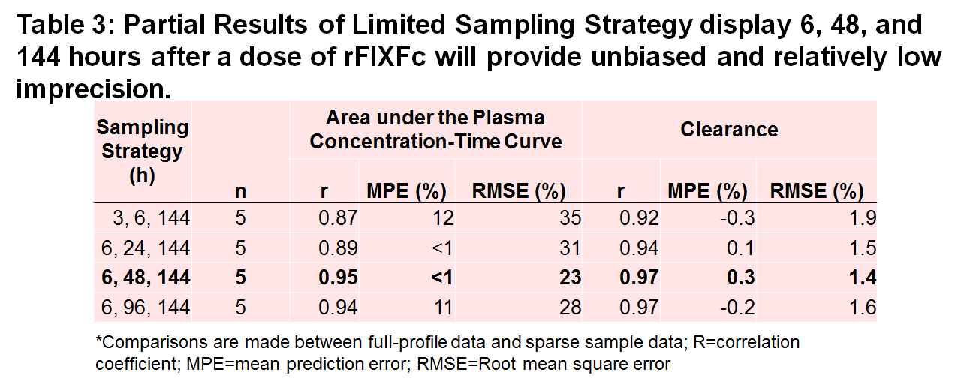
Validation

Slide 75
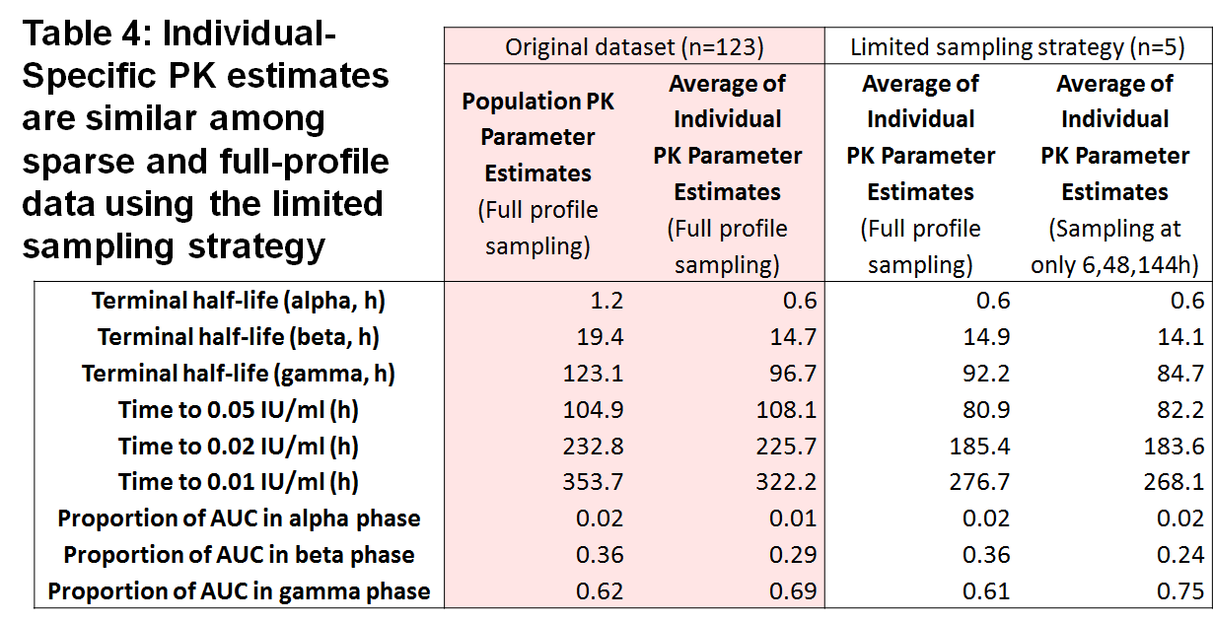
Validation

Slide 76
Thank you !!!
Join the WAPPS network at:
www.wapps-hemo.org
Download these slides at:
Hemophilia.mcmaster.ca

Slide 77
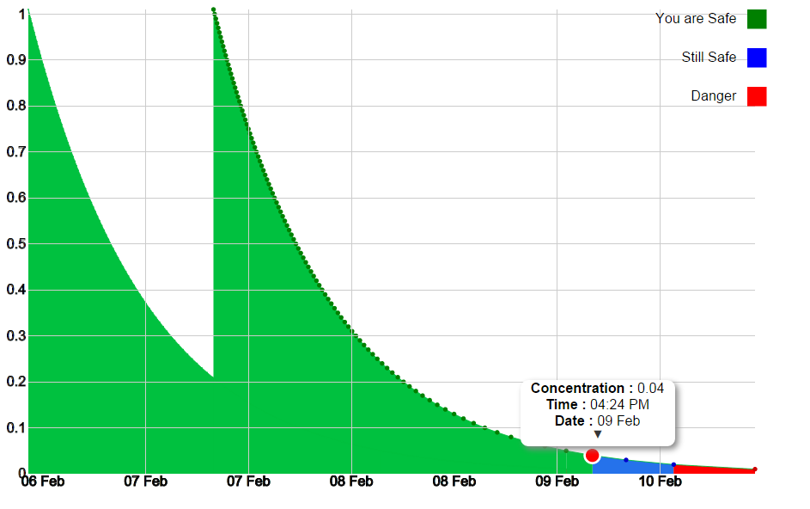
Low risk Medium risk
High risk

Slide 78
www.wapps-hemo.org

Slide 79
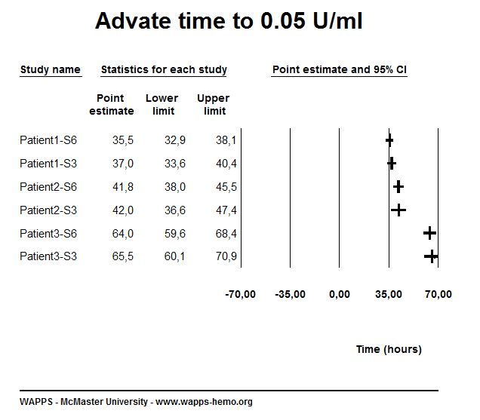

Slide 80


Slide 81


Slide 82


Slide 83


Slide 84


Slide 85


Slide 86


Slide 87


Slide 88


Slide 89


Slide 90


Slide 91


Slide 92


Slide 93


